Slide 1
Applet
An applet is a Java program that runs in a Web browser.

Slide 2
Difference Between Applet and standalone Java Application
An applet is a Java class that extends the java.applet.Applet class.
A main() method is not invoked on an applet, and an applet class will not define main().
Applets are designed to be embedded within an HTML page.
When a user views an HTML page that contains an applet, the code for the applet is downloaded to the user's machine.
A JVM is required to view an applet. The JVM can be either a plug-in of the Web browser or a separate runtime environment.
The JVM on the user's machine creates an instance of the applet class and invokes various methods during the applet's lifetime.
Applets have strict security rules that are enforced by the Web browser. The security of an applet is often referred to as sandbox security, comparing the applet to a child playing in a sandbox with various rules that must be followed.
Other classes that the applet needs can be downloaded in a single Java Archive (JAR) file.

Slide 3
Applet LifeCycle
init: This method is intended for whatever initialization is needed for your applet. It is called after the param tags inside the applet tag have been processed.
start: This method is automatically called after the browser calls the init method. It is also called whenever the user returns to the page containing the applet after having gone off to other pages.
stop: This method is automatically called when the user moves off the page on which the applet sits. It can, therefore, be called repeatedly in the same applet.
destroy: This method is only called when the browser shuts down normally. Because applets are meant to live on an HTML page, you should not normally leave resources behind after a user leaves the page that contains the applet.
paint: Invoked immediately after the start() method, and also any time the applet needs to repaint itself in the browser. The paint() method is actually inherited from the java.awt.

Slide 4
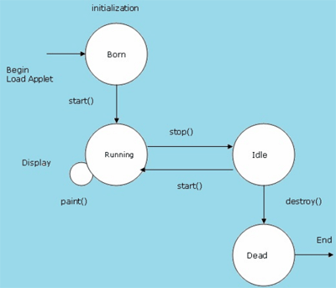
Applet LifeCycle

Slide 5
A "Hello, World" Applet:
import java.applet.*;
import java.awt.*;
public class HelloWorldApplet extends Applet
{
public void paint (Graphics g)
{
g.drawString ("Hello World", 25, 50);
}
}

Slide 6
Applet Tag
Syntax <APPLET>...</APPLET> Attribute Specifications CODE=CDATA (class file)
CODEBASE=URI (base URI for class files)
WIDTH=Length (applet width)
HEIGHT=Length (applet height)
ARCHIVE=CDATA (archive files)
OBJECT=CDATA (serialized applet)
NAME=CDATA (name for inter-applet communication)
ALT=Text (alternate text)
ALIGN=[ top | middle | bottom | left | right ] (applet alignment)
HSPACE=Pixels (horizontal gutter)
VSPACE=Pixels (vertical gutter)

Slide 7
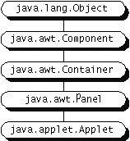
Applet Inheritance Hierarchy
Applet class derives from the Abstract Window Toolkit (AWT) hierarchy.

Slide 8
Useful Applet Methods
getCodeBase, getDocumentBase
The URL of the:
Applet file - getCodeBase
HTML file - getDocumentBase
getParameter
Retrieves the value from the associated HTML PARAM element
getSize
Returns the Dimension (width, height) of the applet
getGraphics
Retrieves the current Graphics object for the applet
The Graphics object does not persist across paint invocations

Slide 9
Useful Applet Methods, (Continued)
showDocument (AppletContext method)
getAppletContext().showDocument(...)
Asks the browser to retrieve and a display a Web page
Can direct page to a named FRAME cell
showStatus(String str)
Displays a string in the status line at the bottom of the browser
getCursor, setCursor
Defines the Cursor for the mouse, for example, CROSSHAIR_CURSOR, HAND_CURSOR, WAIT_CURSOR

Slide 10
Useful Applet Methods, (Continued)
getAudioClip
play
Retrieves an audio file from a remote location and plays it
JDK 1.1 supports .au only. Java 2 also supports MIDI, .aiff and .wav
getBackground, setBackground
Gets/sets the background color of the applet
SystemColor class provides access to desktop colors
getForeground, setForeground
Gets/sets foreground color of applet (default color of drawing operations)

Slide 11
Useful Graphics Methods
drawString(string, left, bottom)
Draws a string in the current font and color with the bottom left corner of the string at the specified location
One of the few methods where the y coordinate refers to the bottom of shape, not the top. But y values are still with respect to the top left corner of the applet window
drawRect(left, top, width, height)
Draws the outline of a rectangle (1-pixel border) in the current color
fillRect(left, top, width, height)
Draws a solid rectangle in the current color
drawLine(x1, y1, x2, y2)
Draws a 1-pixel-thick line from (x1, y1) to (x2, y2)

Slide 12
Useful Graphics Methods, continued
drawOval, fillOval
Draws an outlined and solid oval, where the arguments describe a rectangle that bounds the oval
drawPolygon, fillPolygon
Draws an outlined and solid polygon whose points are defined by arrays or a Polygon (a class that stores a series of points)
By default, polygon is closed; to make an open polygon use the drawPolyline method
drawImage
Draws an image
Images can be in JPEG or GIF (including GIF89A) format

Slide 13
Graphics Color
setColor, getColor
Specifies the foreground color prior to drawing operation
By default, the graphics object receives the foreground color of the window
AWT has 16 predefined colors (Color.red, Color.blue, etc.) or create your own color, new Color(r, g, b)
Changing the color of the Graphics object affects only the drawing that explicitly uses that Graphics object
To make permanent changes, call the applet’s setForeground method.

Slide 14
Graphics Font
setFont, getFont
Specifies the font to be used for drawing text
Determine the size of a character through FontMetrics (in Java 2 use LineMetrics)
Setting the font for the Graphics object does not persist to subsequent invocations of paint
Set the font of the window (I.e., call the applet’s setFont method) for permanent changes to the Graphics object
In JDK 1.1, only 5 fonts are available: Serif (aka TimesRoman), SansSerif (aka Helvetica), Monospaced (aka Courier), Dialog, and DialogInput

Slide 15
Graphics Behavior
Browser calls repaint method to request redrawing of applet
Called when applet first drawn or applet is hidden by another window and then re-exposed
repaint()
“sets flag”
update(Graphics g)
Clears screen, Calls paint
paint(Graphics g)

Slide 16
Drawing Images
Register the Image (from init)
Image image = getImage(getCodeBase(), "file");
Image image = getImage (url);
Loading is done in a separate thread
If URL is absolute, then try/catch block is required
Draw the image (from paint)
g.drawImage(image, x, y, window);
g.drawImage(image, x, y, w, h, window);
May draw partial image or nothing at all
Use the applet (this) for the window argument

Slide 17
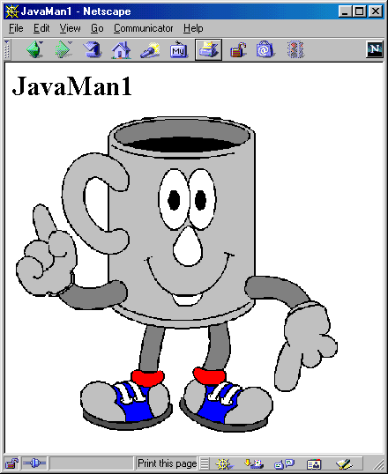
Loading Applet Image from Relative URL
import java.applet.Applet;
import java.awt.*;
/** An applet that loads an image
from a relative URL. */
public class JavaMan1 extends Applet {
private Image javaMan;
public void init() {
javaMan = getImage(getCodeBase(),
"images/Java-Man.gif");
}
public void paint(Graphics g) {
g.drawImage(javaMan, 0, 0, this);
}
}

Slide 18
Loading Applet Image from Absolute URL
import java.applet.Applet;
import java.awt.*;
import java.net.*;
...
private Image javaMan;
public void init() {
try {
URL imageFile =
new URL("http://www.corewebprogramming.com" +
"/images/Java-Man.gif");
javaMan = getImage(imageFile);
} catch(MalformedURLException mue) {
showStatus("Bogus image URL.");
System.out.println("Bogus URL");
}
}

Slide 19
Loading Images in Applications
import java.awt.*;
import javax.swing.*;
class JavaMan3 extends JPanel {
private Image javaMan;
public JavaMan3() {
String imageFile = System.getProperty("user.dir") +
"/images/Java-Man.gif";
javaMan = getToolkit().getImage(imageFile);
setBackground(Color.white);
}
public void paintComponent(Graphics g) {
super.paintComponent(g);
g.drawImage(javaMan, 0, 0, this);
}
...

Slide 20

Loading Images in Applications (Continued)
...
public void paintComponent(Graphics g) {
super.paintComponent(g);
g.drawImage(javaMan, 0, 0, this);
}
public static void main(String[] args) {
JPanel panel = new JavaMan3();
WindowUtilities.setNativeLookAndFeel();
WindowUtilities.openInJFrame(panel, 380, 390);
}
}
See Swing chapter for WindowUtilities

Slide 21
AWT (Abstract Windowing Toolkit)
The AWT is roughly broken into three categories
Components
Layout Managers
Graphics
Many AWT components have been replaced by Swing components
It is generally not considered a good idea to mix Swing components and AWT components. Choose to use one or the other.

Slide 22
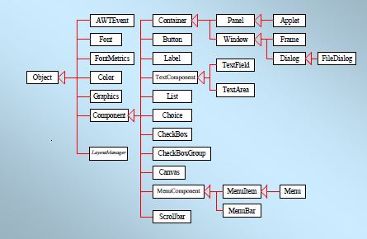
AWT Class Hierarchy
Component
Container
Window
Frame
Button
Panel
List
Checkbox
Choice
Label
TextComponent
TextField
TextArea
Notes:
This slide shows the hierarchy of classes which will be covered in this chapter. If you check the Java API documentation, you will note that there are many more classes in the java.awt package.

Slide 23
Component
Component is the superclass of most of the displayable classes defined within the AWT. Note: it is abstract.
MenuComponent is another class which is similar to Component except it is the superclass for all GUI items which can be displayed within a drop-down menu.
The Component class defines data and methods which are relevant to all Components
setBounds
setSize
setLocation
setFont
setEnabled
setVisible
setForeground -- colour
setBackground -- colour
Notes:
The Component class contains the common features to all items which can be displayed in a GUI. Often, these items are called widgets. In the AWT, all widgets are components and, as such, inherit all the data and methods of the Component class.

Slide 24
Container
Container is a subclass of Component. (ie. All containers are themselves, Components)
Containers contain components
For a component to be placed on the screen, it must be placed within a Container
The Container class defined all the data and methods necessary for managing groups of Components
add
getComponent
getMaximumSize
getMinimumSize
getPreferredSize
remove
removeAll
Notes:
The Container class is an abstract class which encapsulates the logic for managing Components. Note that Containers are, themselves, Components which means that Containers can be placed within other Containers

Slide 25
Windows and Frames
The Window class defines a top-level Window with no Borders or Menu bar.
Usually used for application splash screens
Frame defines a top-level Window with Borders and a Menu Bar
Frames are more commonly used than Windows
Once defined, a Frame is a Container which can contain Components
Frame aFrame = new Frame(Hello World);
aFrame.setSize(100,100);
aFrame.setLocation(10,10);
aFrame.setVisible(true);
Notes:
Generally speaking, the Window class is not used very often. The Frame class, on the other hand, is used quite extensively for GUI based applications.
Another subclass of Window, which is not described here, I the Dialog class. It is used to display Dialog Boxes. Dialog Boxes are generally used to convey important information to the user, and must be dismissed by the user before the application can continue. It should be noted that dialog boxes disrupt the flow of an application and can cause great user frustration if not used appropriately.

Slide 26
Panels
When writing a GUI application, the GUI portion can become quite complex.
To manage the complexity, GUIs are broken down into groups of components. Each group generally provides a unit of functionality.
A Panel is a rectangular Container whose sole purpose is to hold and manage components within a GUI.
Panel aPanel = new Panel();
aPanel.add(new Button("Ok"));
aPanel.add(new Button("Cancel"));
Frame aFrame = new Frame("Button Test");
aFrame.setSize(100,100);
aFrame.setLocation(10,10);
aFrame.add(aPanel);
Notes:
The Panel class is probably the most important class within the AWT. Panels can contain Components (which includes other Panels). It allows the GUI screen to be partitioned into manageable pieces. Panels should contain Components which are functionally related. For example, if an application wished to allow the user to input their name, address, phone number and other relevant contact information, it would be good design to place all of the necessary GUI Components on a Panel. That panel can be then added to and removed from other Containers within the application.

Slide 27
Buttons
This class represents a push-button which displays some specified text.
When a button is pressed, it notifies its Listeners. (More about Listeners in the next chapter).
To be a Listener for a button, an object must implement the ActionListener Interface.
Panel aPanel = new Panel();
Button okButton = new Button("Ok");
Button cancelButton = new Button("Cancel");
aPanel.add(okButton));
aPanel.add(cancelButton));
okButton.addActionListener(controller2);
cancelButton.addActionListener(controller1);
Notes:
All GUI systems offer some form of push button. The Button class in Java represents that functionality. Buttons are typically single purpose (ie. Their function does not change).

Slide 28
Labels
This class is a Component which displays a single line of text.
Labels are read-only. That is, the user cannot click on a label to edit the text it displays.
Text can be aligned within the label
Label aLabel = new Label("Enter password:");
aLabel.setAlignment(Label.RIGHT);
aPanel.add(aLabel);
Notes:
Many GUI applications require users to input data within TextFields, TextAreas, dropdown boxes, etc. However, presenting the user with an series of TextFields without any description would provide a great deal of confusion to the user. All GUI systems allow for the addition of Labels to the interface which provide textual information which aids in the description of the interface itself.

Slide 29
List
This class is a Component which displays a list of Strings.
The list is scrollable, if necessary.
Sometimes called Listbox in other languages.
Lists can be set up to allow single or multiple selections.
The list will return an array indicating which Strings are selected
List aList = new List();
aList.add("Calgary");
aList.add("Edmonton");
aList.add("Regina");
aList.add("Vancouver");
aList.setMultipleMode(true);
Notes:
The List class comes under many names in different GUI systems. Lists provide a list of strings (which is scrollable space the strings take up exceeds the allotted screen real estate) which can be selected by the user. The programmer may allow the user to select multiple strings within the list.

Slide 30
Checkbox
This class represents a GUI checkbox with a textual label.
The Checkbox maintains a boolean state indicating whether it is checked or not.
If a Checkbox is added to a CheckBoxGroup, it will behave like a radio button.
Checkbox creamCheckbox = new CheckBox("Cream");
Checkbox sugarCheckbox = new CheckBox("Sugar");
if (creamCheckbox.getState())
{
coffee.addCream();
}
Notes:
Checkboxes allow for yes/no selections by the user. Each checkbox maintains an internal state indicating whether it is selected or not. If it is selected, it will display itself in such a manner as to indicate it is selected. The state of a checkbox can be queried through the getState method.
Multiple checkboxes will all behave independently of one another meaning each one can be individually checked or unchecked. However, if a group of checkboxes are associated with a CheckBoxGroup object, then only one of the checkboxes can be selected at any one time. It is through the use of CheckBoxGroup that the AWT provides RadioButton functionality.

Slide 31
Choice
This class represents a dropdown list of Strings.
Similar to a list in terms of functionality, but displayed differently.
Only one item from the list can be selected at one time and the currently selected element is displayed.
Choice aChoice = new Choice();
aChoice.add("Calgary");
aChoice.add("Edmonton");
aChoice.add("Alert Bay");
String selectedDestination= aChoice.getSelectedItem();
Notes:
This class provides a list of strings to choose from (just like a list does) but the list is not displayed to the user at all times. Instead, the user must click the Choice to reveal the list. Once revealed, the user may select one of the items within the list. The currently selected item is displayed.

Slide 32
TextField
This class displays a single line of optionally editable text.
This class inherits several methods from TextComponent.
This is one of the most commonly used Components in the AWT
TextField emailTextField = new TextField();
TextField passwordTextField = new TextField();
passwordTextField.setEchoChar("*");
[…]
String userEmail = emailTextField.getText();
String userpassword = passwordTextField.getText();
Notes:
A TextField provides the user with a location that he/she may input a single line of text. Most TextFields are used in conjunction with a Label. The text provided by the label should describe the purpose (and thus, the expected input for) the TextField.

Slide 33
TextArea
This class displays multiple lines of optionally editable text.
This class inherits several methods from TextComponent.
TextArea also provides the methods: appendText(), insertText() and replaceText()
// 5 rows, 80 columns
TextArea fullAddressTextArea = new TextArea(5, 80);
String userFullAddress= fullAddressTextArea.getText();
Notes:
If the user is to input multiple lines of text, a TextArea is used instead of a TextField.

Slide 34
Layout Managers: Outline
How layout managers simplify interface design?
Standard layout managers
FlowLayout, BorderLayout, CardLayout, GridLayout, GridBagLayout, BoxLayout
Positioning components manually
Strategies for using layout managers effectively
Using invisible components

Slide 35
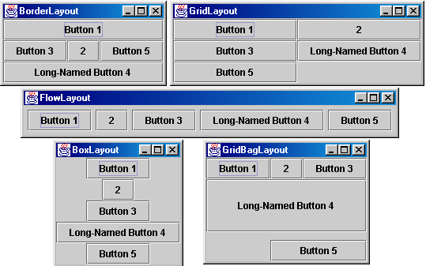
Layout Managers

Slide 36
Layout Managers
Assigned to each Container
Give sizes and positions to components in the window
Helpful for windows whose size changes or that display on multiple operating systems
Relatively easy for simple layouts
But, it is surprisingly hard to get complex layouts with a single layout manager
Controlling complex layouts
Use nested containers (each with its own layout manager)
Use invisible components and layout manager options
Write your own layout manager
Turn layout managers off and arrange things manually

Slide 37
FlowLayout
Default layout for Panel and Applet
Behavior
Resizes components to their preferred size
Places components in rows left to right, top to bottom
Rows are centered by default
Constructors
FlowLayout()
Centers each row and keeps 5 pixels between entries in a row and between rows
FlowLayout(int alignment)
Same 5 pixels spacing, but changes the alignment of the rows
FlowLayout.LEFT, FlowLayout.RIGHT, FlowLayout.CENTER
FlowLayout(int alignment, int hGap, int vGap)
Specify the alignment as well as the horizontal and vertical spacing between components

Slide 38
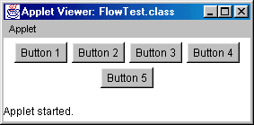
FlowLayout: Example
public class FlowTest extends Applet {
public void init() {
// setLayout(new FlowLayout()); [Default]
for(int i=1; i<6; i++) {
add(new Button("Button " + i));
}
}
}

Slide 39
BorderLayout
Default layout for Frame and Dialog
Behavior
Divides the Container into five regions
Each region is identified by a corresponding BorderLayout constant
NORTH, SOUTH, EAST, WEST, and CENTER
NORTH and SOUTH respect the preferred height of the component
EAST and WEST respect the preferred width of the component
CENTER is given the remaining space
Is allowing a maximum of five components too restrictive? Why not?

Slide 40
BorderLayout (Continued)
Constructors
BorderLayout()
Border layout with no gaps between components
BorderLayout(int hGap, int vGap)
Border layout with the specified empty pixels between regions
Adding Components
add(component, BorderLayout.REGION)
Always specify the region in which to add the component
CENTER is the default, but specify it explicitly to avoid confusion with other layout managers

Slide 41
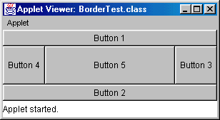
BorderLayout: Example
public class BorderTest extends Applet {
public void init() {
setLayout(new BorderLayout());
add(new Button("Button 1"), BorderLayout.NORTH);
add(new Button("Button 2"), BorderLayout.SOUTH);
add(new Button("Button 3"), BorderLayout.EAST);
add(new Button("Button 4"), BorderLayout.WEST);
add(new Button("Button 5"), BorderLayout.CENTER);
}
}

Slide 42
GridLayout
Behavior
Divides window into equal-sized rectangles based upon the number of rows and columns specified
Items placed into cells left-to-right, top-to-bottom, based on the order added to the container
Ignores the preferred size of the component; each component is resized to fit into its grid cell
Too few components results in blank cells
Too many components results in extra columns

Slide 43
GridLayout (Continued)
Constructors
GridLayout()
Creates a single row with one column allocated per component
GridLayout(int rows, int cols)
Divides the window into the specified number of rows and columns
Either rows or cols (but not both) can be zero
GridLayout(int rows, int cols, int hGap, int vGap)
Uses the specified gaps between cells

Slide 44
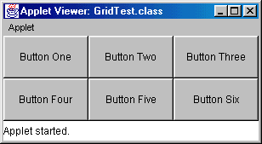
GridLayout, Example
public class GridTest extends Applet {
public void init() {
setLayout(new GridLayout(2,3)); // 2 rows, 3 cols
add(new Button("Button One"));
add(new Button("Button Two"));
add(new Button("Button Three"));
add(new Button("Button Four"));
add(new Button("Button Five"));
add(new Button("Button Six"));
}
}

Slide 45
CardLayout
Behavior
Stacks components on top of each other, displaying the top one
Associates a name with each component in window
Panel cardPanel;
CardLayout layout new CardLayout();
cardPanel.setLayout(layout);
...
cardPanel.add("Card 1", component1);
cardPanel.add("Card 2", component2); ...
layout.show(cardPanel, "Card 1");
layout.first(cardPanel);
layout.next(cardPanel);

Slide 46
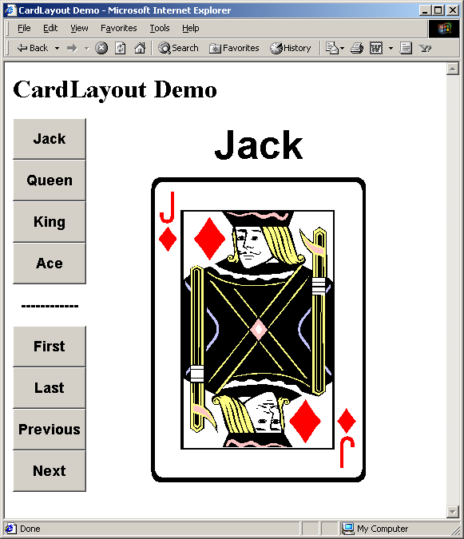
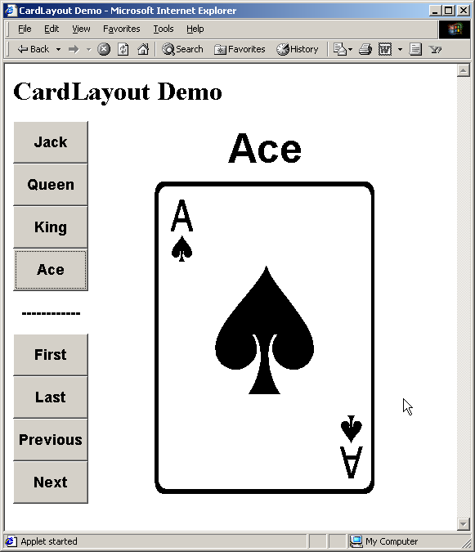
CardLayout, Example

Slide 47
GridBagLayout
Behavior
Divides the window into grids, without requiring the components to be the same size
About three times more flexible than the other standard layout managers, but nine times harder to use
Each component managed by a grid bag layout is associated with an instance of GridBagConstraints
The GridBagConstraints specifies:
How the component is laid out in the display area
In which cell the component starts and ends
How the component stretches when extra room is available
Alignment in cells

Slide 48
GridBagLayout: Basic Steps
Set the layout, saving a reference to it
GridBagLayout layout = new GridBagLayout();
setLayout(layout);
Allocate a GridBagConstraints object
GridBagConstraints constraints =
new GridBagConstraints();
Set up the GridBagConstraints for component 1
constraints.gridx = x1;
constraints.gridy = y1;
constraints.gridwidth = width1;
constraints.gridheight = height1;
Add component 1 to the window, including constraints
add(component1, constraints);
Repeat the last two steps for each remaining component

Slide 49
GridBagConstraints
Copied when component added to window
Thus, can reuse the GridBagConstraints
GridBagConstraints constraints = new GridBagConstraints();
constraints.gridx = x1;
constraints.gridy = y1;
constraints.gridwidth = width1;
constraints.gridheight = height1;
add(component1, constraints);
constraints.gridx = x1;
constraints.gridy = y1;
add(component2, constraints);

Slide 50
GridBagConstraints Fields
gridx, gridy
Specifies the top-left corner of the component
Upper left of grid is located at (gridx, gridy)=(0,0)
Set to GridBagConstraints.RELATIVE to auto-increment row/column
GridBagConstraints constraints = new GridBagConstraints();
constraints.gridx = GridBagConstraints.RELATIVE;
container.add(new Button("one"), constraints);
container.add(new Button("two"), constraints);

Slide 51
GridBagConstraints Fields
gridwidth, gridheight
Specifies the number of columns and rows the Component occupies
constraints.gridwidth = 3;
GridBagConstraints.REMAINDER lets the component take up the remainder of the row/column
weightx, weighty
Specifies how much the cell will stretch in the x or y direction if space is left over
constraints.weightx = 3.0;
Constraint affects the cell, not the component (use fill)
Use a value of 0.0 for no expansion in a direction
Values are relative, not absolute

Slide 52
GridBagConstraints Fields
fill
Specifies what to do to an element that is smaller than the cell size constraints.fill = GridBagConstraints.VERTICAL;
The size of row/column is determined by the widest/tallest element in it
Can be NONE, HORIZONTAL, VERTICAL, or BOTH
anchor
If the fill is set to GridBagConstraints.NONE, then the anchor field determines where the component is placed
constraints.anchor = GridBagConstraints.NORTHEAST;
Can be NORTH, EAST, SOUTH, WEST, NORTHEAST, NORTHWEST, SOUTHEAST, or SOUTHWEST

Slide 53
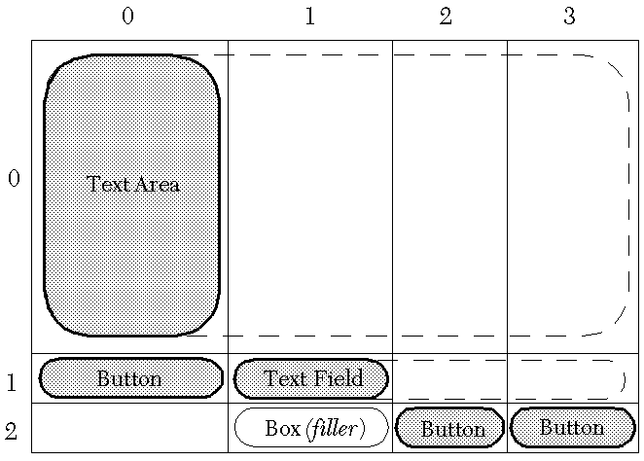
GridBagLayout: Example

Slide 54
GridBagLayout, Example
public GridBagTest() {
setLayout(new GridBagLayout());
textArea = new JTextArea(12, 40);
// 12 rows, 40 cols
bSaveAs = new JButton("Save As");
fileField = new JTextField("C:\\Document.txt");
bOk = new JButton("OK");
bExit = new JButton("Exit");
GridBagConstraints c = new GridBagConstraints();
// Text Area.
c.gridx = 0;
c.gridy = 0;
c.gridwidth = GridBagConstraints.REMAINDER;
c.gridheight = 1;
c.weightx = 1.0;
c.weighty = 1.0;
c.fill = GridBagConstraints.BOTH;
c.insets = new Insets(2,2,2,2); //t,l,b,r
add(textArea, c);
...
// Save As Button.
c.gridx = 0;
c.gridy = 1;
c.gridwidth = 1;
c.gridheight = 1;
c.weightx = 0.0;
c.weighty = 0.0;
c.fill = GridBagConstraints.VERTICAL;
add(bSaveAs,c);
// Filename Input (Textfield).
c.gridx = 1;
c.gridwidth = GridBagConstraints.REMAINDER;
c.gridheight = 1;
c.weightx = 1.0;
c.weighty = 0.0;
c.fill = GridBagConstraints.BOTH;
add(fileField,c);
...

Slide 55
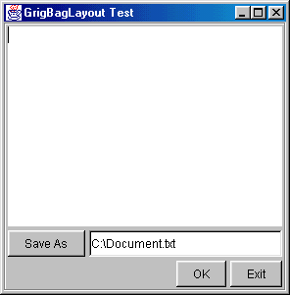
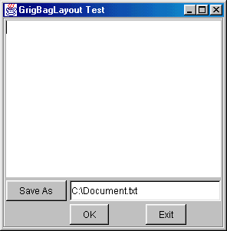
GridBagLayout, Example
// Exit Button.
c.gridx = 3;
c.gridwidth = 1;
c.gridheight = 1;
c.weightx = 0.0;
c.weighty = 0.0;
c.fill = GridBagConstraints.NONE;
add(bExit,c);
// Filler so Column 1 has nonzero width.
Component filler =
Box.createRigidArea(new Dimension(1,1));
c.gridx = 1;
c.weightx = 1.0;
add(filler,c);
...
}
With / Without Box filler at (2,1)

Slide 56
Disabling the Layout Manager
Behavior
If the layout is set to null, then components must be sized and positioned by hand
Positioning components
component.setSize(width, height)
component.setLocation(left, top)
or
component.setBounds(left, top, width, height)

Slide 57
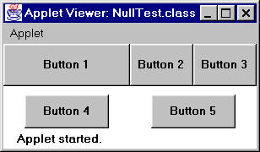
No Layout Manager, Example
setLayout(null);
Button b1 = new Button("Button 1");
Button b2 = new Button("Button 2");
...
b1.setBounds(0, 0, 150, 50);
b2.setBounds(150, 0, 75, 50);
...
add(b1);
add(b2);
...

Slide 58
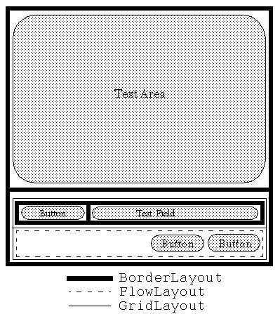
Nested Containers, Example

Slide 59
Nested Containers, Example
public NestedLayout() {
setLayout(new BorderLayout(2,2));
textArea = new JTextArea(12,40); // 12 rows, 40 cols
bSaveAs = new JButton("Save As");
fileField = new JTextField("C:\\Document.txt");
bOk = new JButton("OK");
bExit = new JButton("Exit");
add(textArea,BorderLayout.CENTER);
// Set up buttons and textfield in bottom panel.
JPanel bottomPanel = new JPanel();
bottomPanel.setLayout(new GridLayout(2,1));

Slide 60
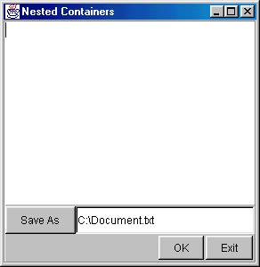
Nested Containers, Example
JPanel subPanel1 = new JPanel();
JPanel subPanel2 = new JPanel();
subPanel1.setLayout(new BorderLayout());
subPanel2.setLayout(new FlowLayout(FlowLayout.RIGHT,2,2));
subPanel1.add(bSaveAs,BorderLayout.WEST);
subPanel1.add(fileField,BorderLayout.CENTER);
subPanel2.add(bOk);
subPanel2.add(bExit);
bottomPanel.add(subPanel1);
bottomPanel.add(subPanel2);
add(bottomPanel,BorderLayout.SOUTH);
}

Slide 61
Turning Off Layout Manager for Some Containers, Example
Suppose that you wanted to arrange a column of buttons (on the left) that take exactly 40% of the width of the container
setLayout(null);
int width1 = getSize().width*4/10;,
int height = getSize().height;
Panel buttonPanel = new Panel();
buttonPanel.setBounds(0, 0, width1, height);
buttonPanel.setLayout(new GridLayout(6, 1));
buttonPanel.add(new Label("Buttons", Label.CENTER));
buttonPanel.add(new Button("Button One"));
...
buttonPanel.add(new Button("Button Five"));
add(buttonPanel);
Panel everythingElse = new Panel();
int width2 = getSize().width - width1,
everythingElse.setBounds(width1+1, 0, width2, height);

Slide 62
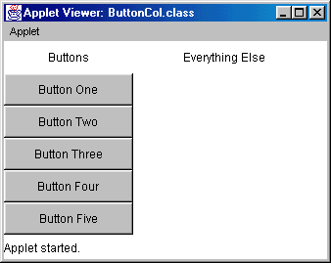
Turning Off Layout Manager for Some Containers: Result

Slide 63
Adjusting Space Around Components
Change the space allocated by the layout manager
Most LayoutManagers accept a horizontal spacing (hGap) and vertical spacing (vGap) argument
For GridBagLayout, change the insets
Use a Canvas or a Box as an invisible spacer
For AWT layouts, use a Canvas that does not draw or handle mouse events as an “empty” component for spacing.
For Swing layouts, add a Box as an invisible spacer to improve positioning of components

Slide 64
Invisible Components in Box Class
Rigid areas
Box.createRigidArea(Dimension dim)
Creates a two-dimensional invisible Component with a fixed width and height
Component spacer =
Box.createRigidArea(new Dimension(30, 40));
Struts
Box.createHorizontalStrut(int width)
Box.createVerticalStrut(int width)
Creates an invisible Component of fixed width and zero height, and an invisible Component of fixed height and zero width, respectively

Slide 65
Invisible Components in Box Class (Continued)
Glue
Box.createHorizontalGlue()
Box.createVerticalGlue()
Create an invisible Component that can expand horizontally or vertically, respectively, to fill all remaining space
Box.createGlue()
Creates a Component that can expand in both directions
A Box object achieves the glue effect by expressing a maximum size of Short.MAX_VALUE
Only apply glue to layout managers that respect the maximum size of a Component

Slide 66
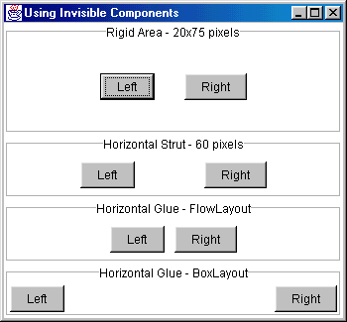
Invisible Components: Example

Slide 67
BoxLayout
Behavior
Manager from Swing; available only in Java 2
Arranges Components either in a horizontal row, BoxLayout.X_AXIS, or in a vertical column, BoxLayout.Y_AXIS
Lays out the components in the order in which they were added to the Container
Resizing the container does not cause the components to relocate
Unlike the other standard layout managers, the BoxLayout manager cannot be shared with more than one Container
BoxLayout layout =
new BoxLayout(container, BoxLayout.X_AXIS);

Slide 68
Component Arrangement for BoxLayout
Attempts to arrange the components with:
Their preferred widths (vertical layout), or
Their preferred heights (horizontal layout)
Vertical Layout
If the components are not all the same width, BoxLayout attempts to expand all the components to the width of the component with the largest preferred width
If expanding a component is not possible (restricted maximum size), BoxLayout aligns that component horizontally in the container, according to the x alignment of the component

Slide 69
Component Arrangement for BoxLayout (Continued)
Horizontal Layout
If the components are not all the same height, BoxLayout attempts to expand all the components to the height of the tallest component
If expanding the height of a component is not possible, BoxLayout aligns that component vertically in the container, according to the y alignment of the component.

Slide 70
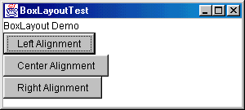
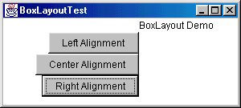
BoxLayout: Example
All components have a 0.0 (left) alignment
The label has a 0.0 alignment
The buttons have a 1.0 (right) alignment

